Slide 1

Web Scraping Project :
How much salary can you expect for your tech skill?
Sean Hong

Slide 2

INTRODUCTION
What are your special skills?
JAVA, SQL !
Python, R !
C++ !
Blockchain !
Android, iOS !

Slide 3
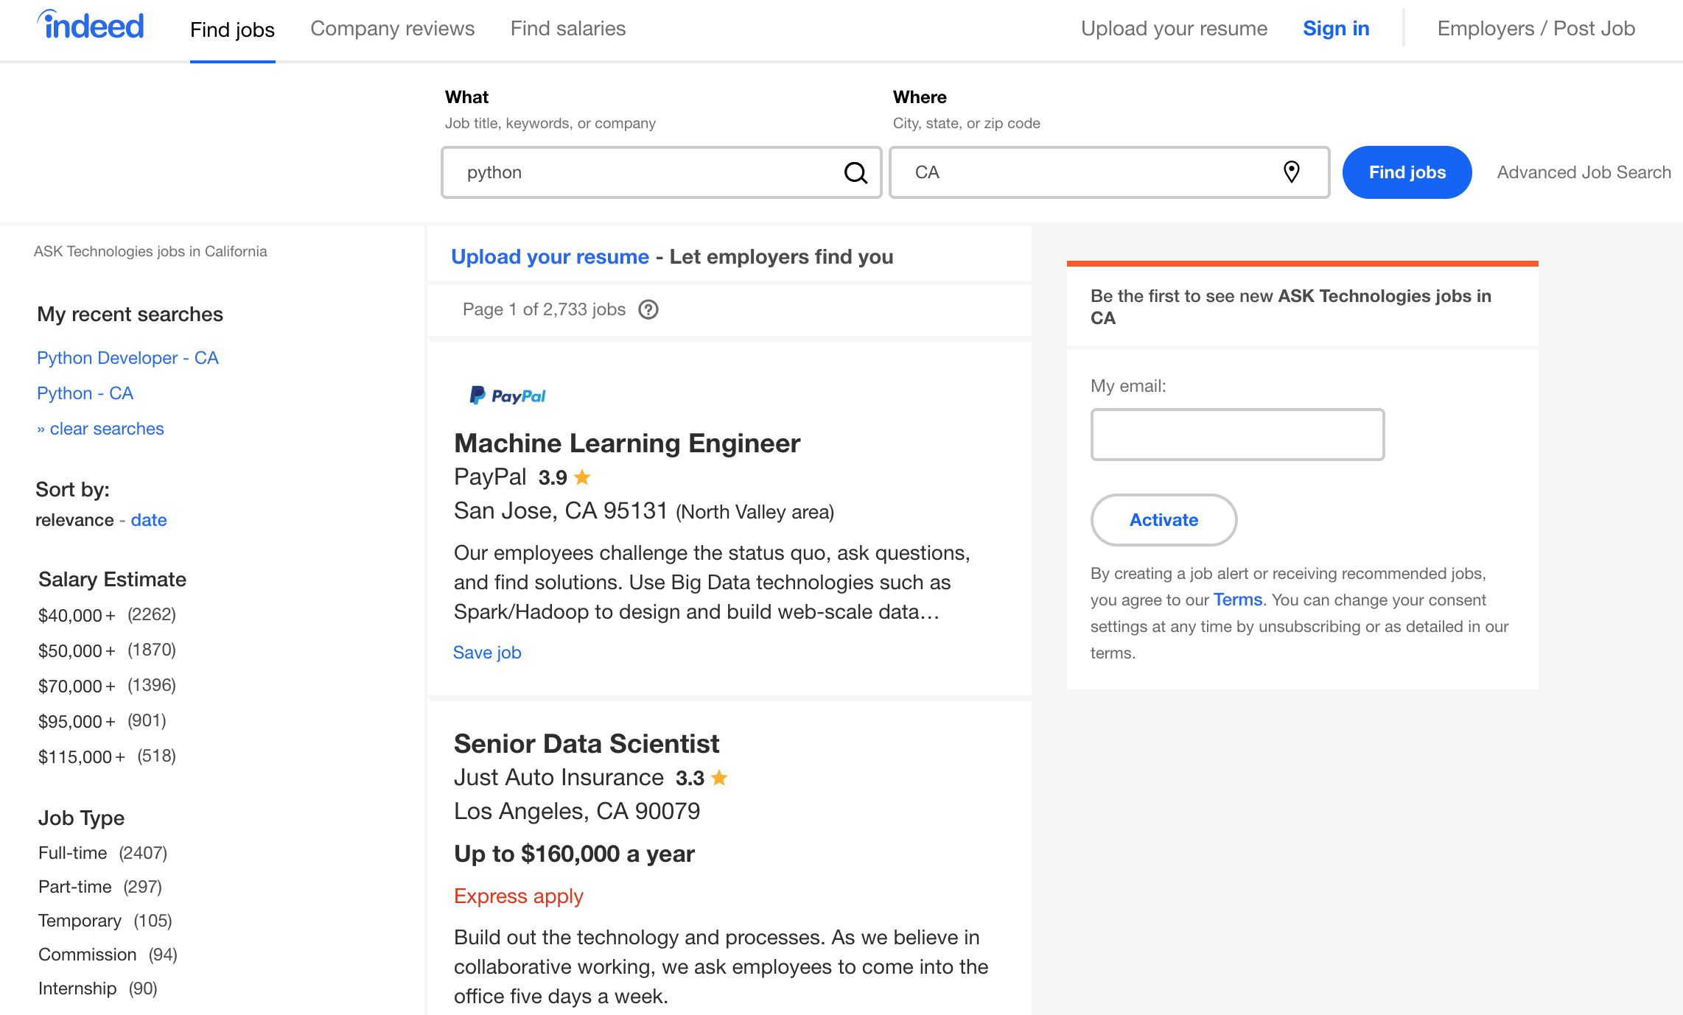
WEB CRAWLING
https://www.indeed.com
keyword
location
salary

Slide 4
HOW TO
Web Crawler : Scrapy
Cleansing & Visualization : Pandas, NumPy, Plotly
Search skill keywords from web (stackoverflow, google) & select 25 popular keywords.
java, python, r, sql, hadoop, spark, c#, c++, javascript, angular, node.js, linux, tensorflow, kubernetes, docker, android, ios, aws, azure, kafka, vb, php, scala, go…
Develop scrapy application to Input each keyword into indeed.com search engine.
URL : https://www.indeed.com/jobs?q={keyword}&l={location}&limit=50&start={50 * (page -1)}
Iterate keywords & collect job results of URL request call.
Skip job results that have not salary information.
Save to CSV file.
There is 1,000 count limitation of search result.
Add more condition to get more sample
Location : CA, NY, FL, TX…
Level : entry, mid, senior

Slide 5
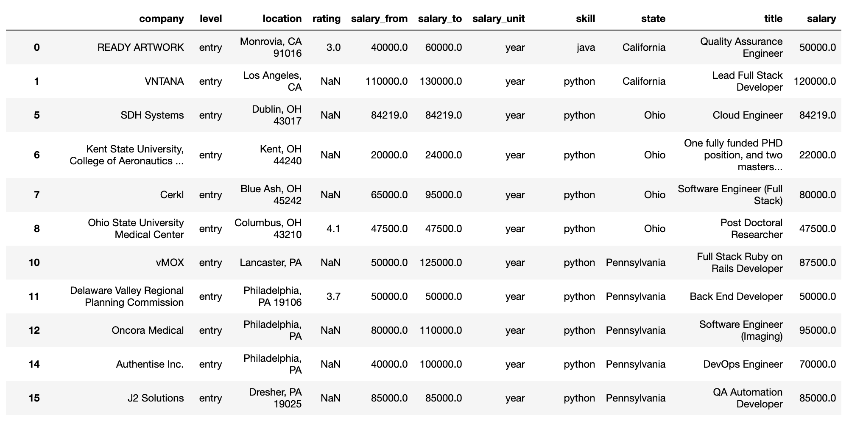
DATA SET
salary = (salary_from + salary_to) / 2
If salary unit is month, salary * 12

Slide 6
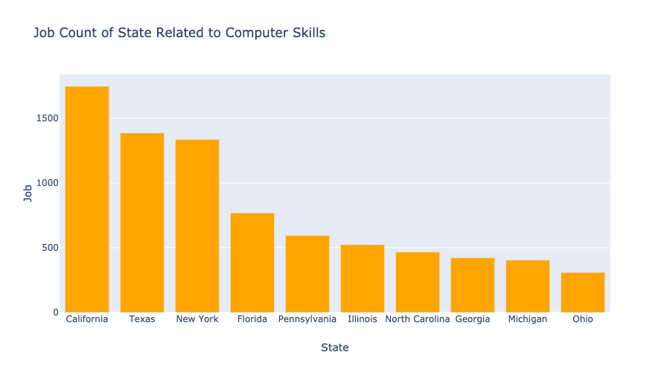
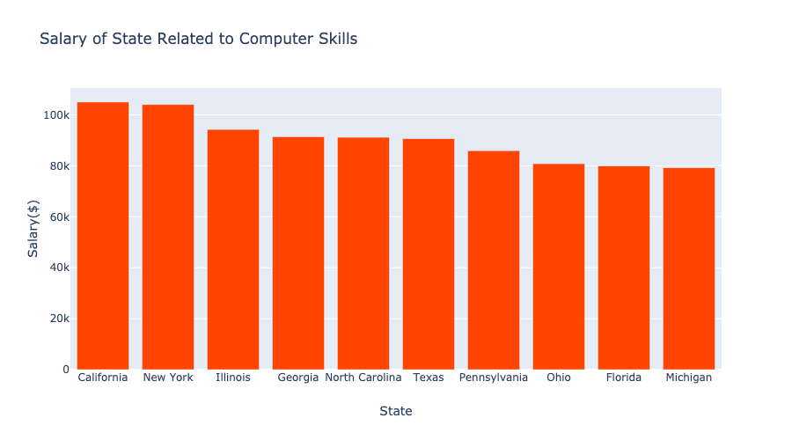
BASIC ANALYSIS #1
Job count seems to depends on population. But New York is much higher than Florida.
California & New York has the highest average salary.

Slide 7
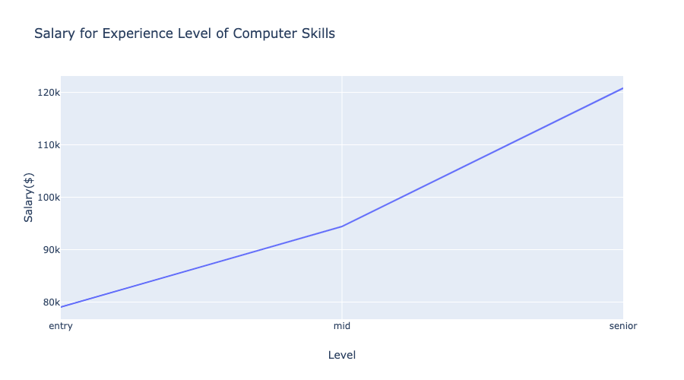
BASIC ANALYSIS #2
Absolutely, skill level is related to salary. Level is one of search condition from indeed.com.

Slide 8
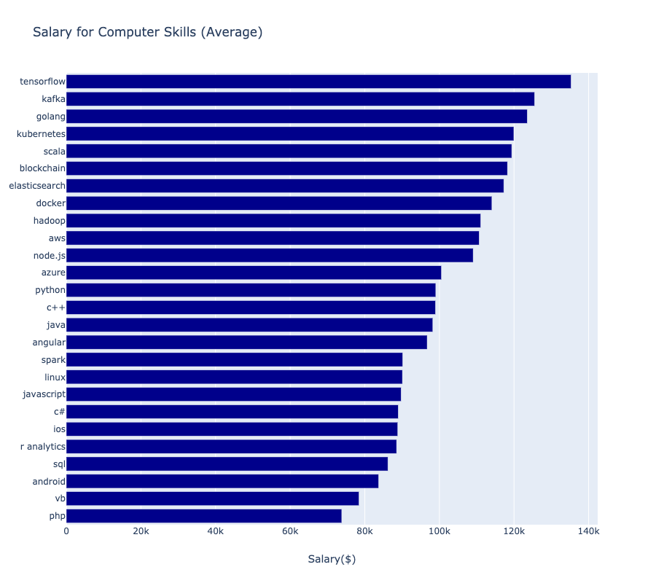
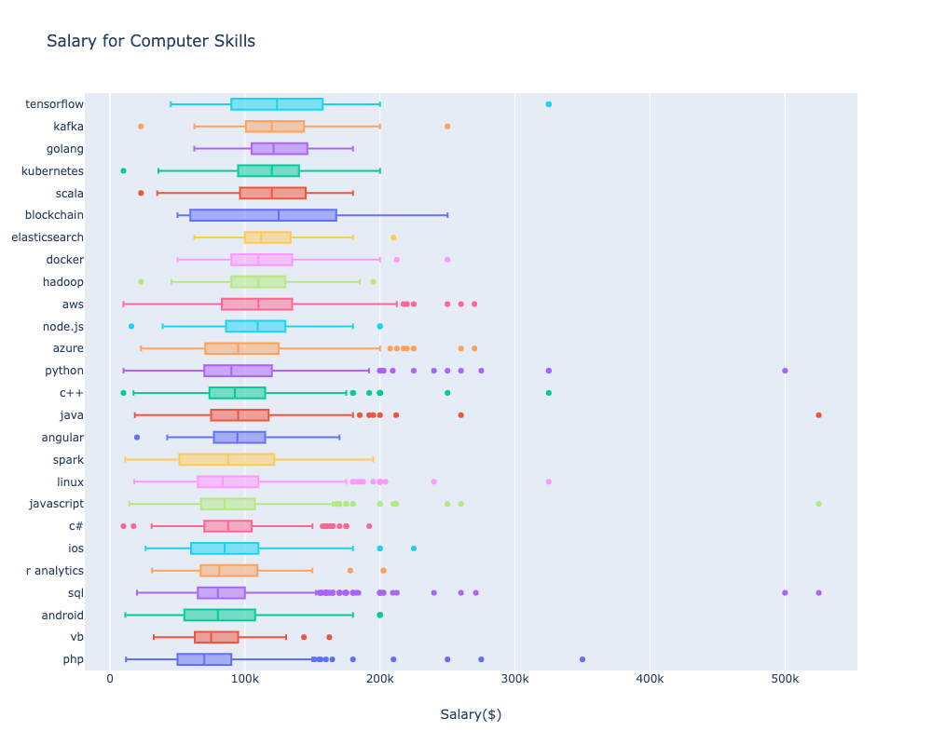
MAIN ANALYSIS #1
It looks the latest technology’s skills (AI, Cloud, Blockchain) can get high salary.

Slide 9
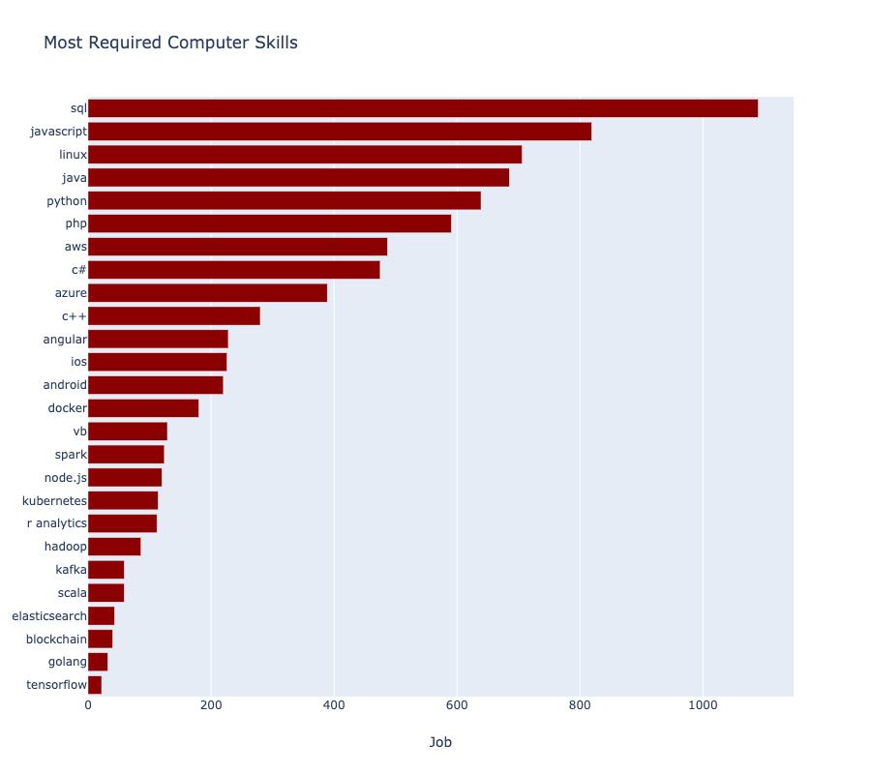
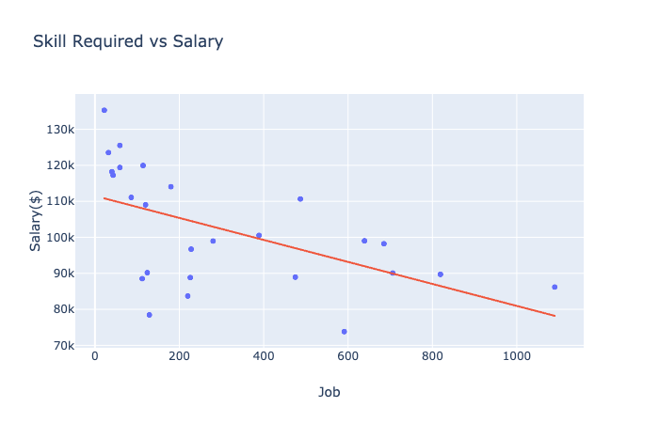
MAIN ANALYSIS #2
Most common skill is SQL. Because It uses everywhere.
Common and general skill seems that cannot get high salary. Learn special tech skill!!

Slide 10
FUTURE WORK
If skills are more than one, is it relate to get more salary?
Try to search mixed keyword.
Ex) java + sql, python + r…
Amount of sample is not enough because many companies don’t want to show their salary directly.
Find how to get more sample.
Use machine learning and predict salary.

